Slide 1
Adding a Charging Station to your City

Slide 2
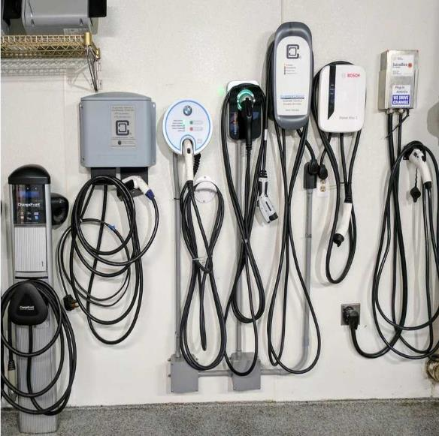
Charging Equipment Manufacturers
Charging companies provide either the physical equipment, the network, or both
Many options exist that provide quality products and services
• Once you know what style of charging station you want, research available options
Common manufacturers include ChargePoint, ZEF Energy, eMotorwerks, and ClipperCreek
Photo: insideevs.com
Notes:
First bullet: Think of it like a cell phone. Some companies sell just the phone, some sell the software that powers the phone, some do both. ChargePoint has a closed network, whereas others may allow more open source use. There is no clear advantage, many companies provide high quality products both ways.

Slide 3
EV Charging Station Funding
Cooperative purchasing includes electric vehicle supply equipment (EVSE)
Available via the state contract and Sourcewell
The US Department of Energy has a list of charging incentives by utility—check for yours!
Sign-up for updates on VW Settlement funding
https://www.pca.state.mn.us/air/volkswagen-settlement
Notes:
Find out whether your utility offers any incentives: https://www.energy.gov/eere/electricvehicles/electric-vehicles-tax-credits-and-other-incentives

Slide 4
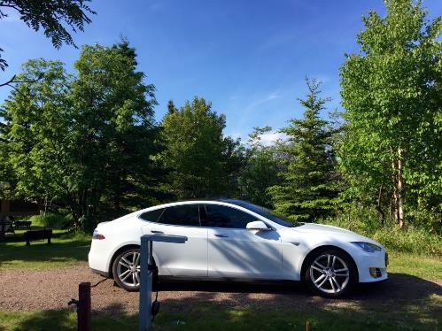
Attract EV Drivers to Your City!
Adding an EV charging station attracts EV drivers to your city
Tourism is an important part of charging infrastructure
Many drivers report how happy they are a station has been added to a destination around MN!

Slide 5
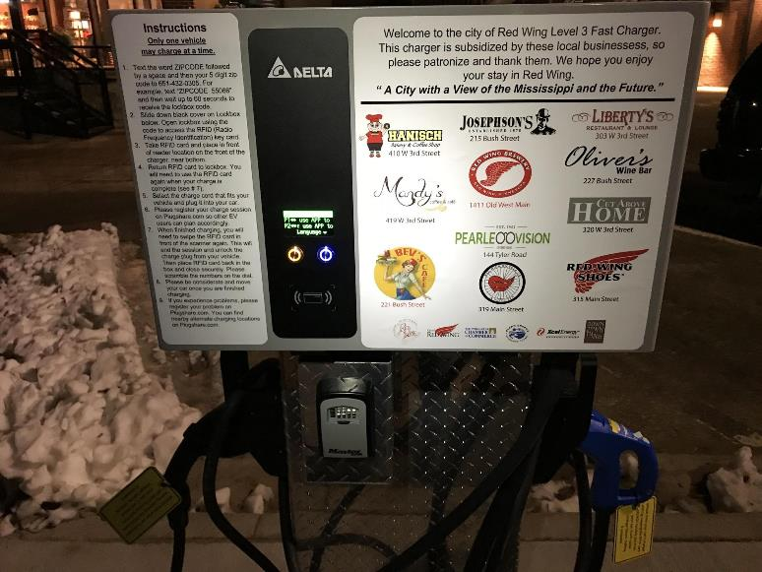
Red Wing’s New DCFC
The City of Red Wing purchased a 25kW DCFC
Installed in a public lot
In exchange for sponsoring the project and paying for the electricity, local businesses advertise on the unit!
Notes:
More information can be found here: https://www.republican-eagle.com/business/technology/4532466-plug-and-power-red-wings-electric-vehicle-charger-officially-online

Slide 6
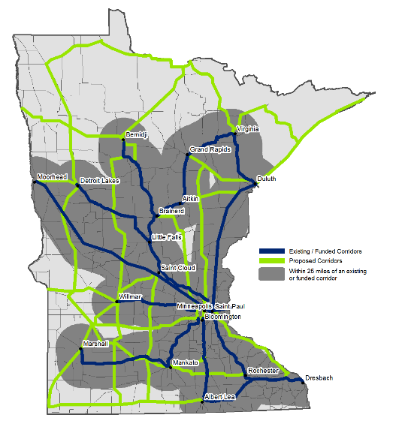
VW Settlement DCFC Plans
Volkswagen Settlement money is going to build up a DCFC network around Minnesota
Phase 1 is done but expect more in 2020+
Notes:
More information here: https://www.pca.state.mn.us/air/volkswagen-settlement

Slide 7
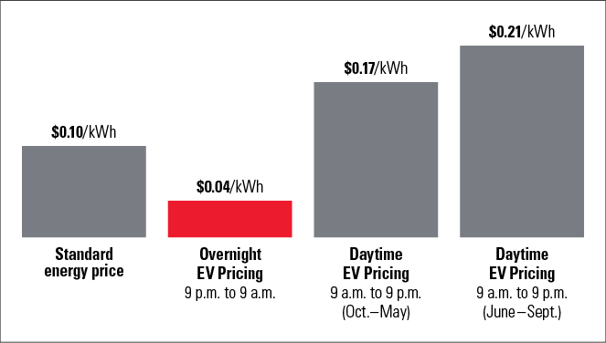
Time of Use Charging
Off peak charging cuts down on charging costs
Every public utility in the state has an EV plan
Ask your utility what programs they have for your city!
May be most applicable to fleet charging
Xcel Energy's EV rates
Notes:
Charging your EV during off peak times allows you to take advantage of better utility rates. Overnight charging is a perfect way to save your city money while charging your electric vehicle. You can push the cost of fueling down to a tiny fraction of an ICE vehicle.

Slide 8
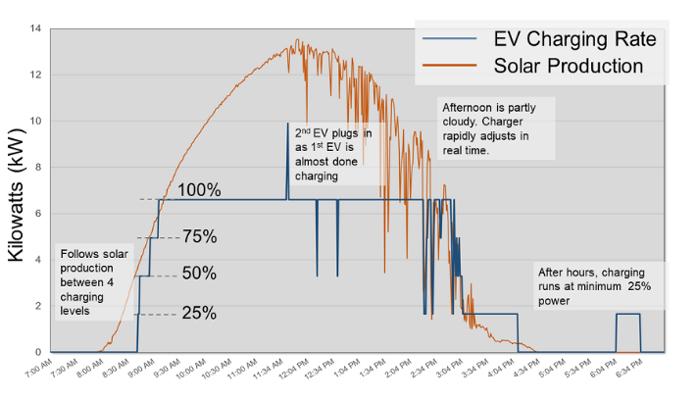
Renewables and Charging
Pairing charging with renewable energy means zero emission driving!
Solar during the day; wind at night
Workplace charging is a perfect place to use solar; offsets demand
Direct installation or sign-up via utility programs
Data from the solar array at Great Plains Institute’s office building. Note how the solar power changes during the day!
Notes:
To find renewable programs, go to your utility's website and look for a Programs section. As renewables become more and more available, utilities across the state are offering better programs to help you get green energy. This article is also a great place to learn more: http://www.driveelectricmn.org/renewable-charging-options-in-minnesota-for-your-plug-in-electric-vehicle/

Slide 9
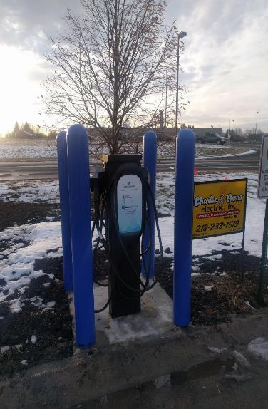
“Smart” vs. “Dumb” Charger
"Smart" Charger
"Dumb" Charger
Allows data collection and usage statistics
Enables requiring payment for use
Adds cost upfront
Requires a data plan or network subscription to maintain
Available on Level 2 charging stations
Enables load distribution sharing and monitoring
Does not allow for usage statistics
Usually no way to require payment for usage
Much cheaper equipment
No data or service plan required
Notes:
This dichotomy is sometimes known as networked vs non-networked charging.

Slide 10
To Charge for Power or Not?
Level 2: extra equipment cost required to collect payment generally outweighs the potential for income from charging users
There are some creative ways to collect payment with a "dumb" charger
DC Fast Chargers: many choose to charge fees due to the expensive installation costs, knowing it is unlikely that you will recoup the price of installation
Notes:
Slide 45 presents information about creative payment methods.

Slide 11
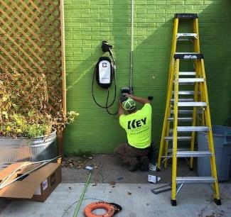
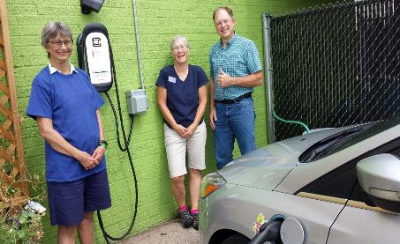
Bluff Country Co-op
Asks for a suggested donation of $2 per hour of charge
People give money to cashiers inside the co-op
Allowed the co-op to install a cheaper, level 2 station and still receive income from folks using it!
Notes:
More information about this project can be found here: http://www.driveelectricmn.org/a-grocery-co-ops-creative-solution-for-offering-electric-vehicle-charging/

Slide 12
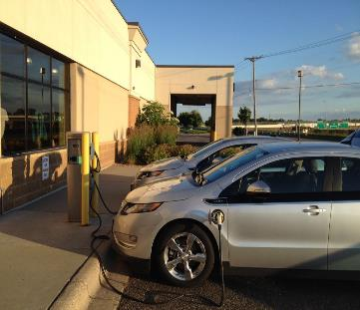
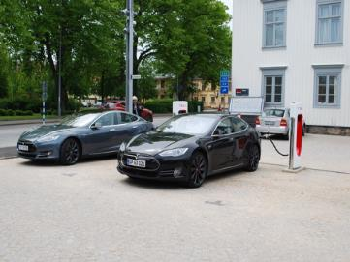
Where to Locate Chargers in a Community
Good site locations: Anywhere people stop for 2+ hours (theaters, restaurants, shops, ski hills, etc.)
For DCFC infrastructure: install them along major public corridors and near amenities for maximum use
See the Drive Electric MN site selection tools!
Notes:
Helpful blog post: http://www.driveelectricmn.org/close-up-of-dc-fast-chargers-in-minnesota/
Link to the Drive Electric MN Site Selection Tool: http://www.driveelectricmn.org/charging-guidance/

Slide 13
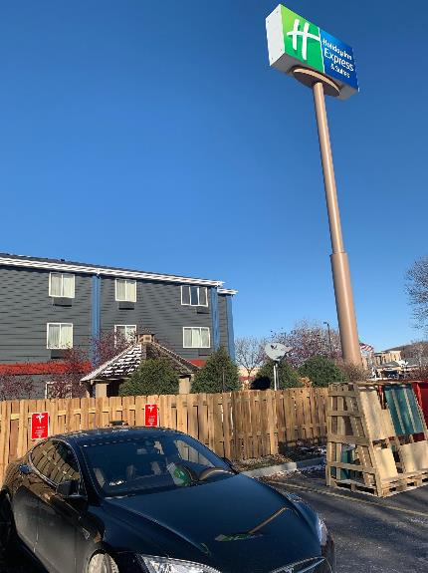
Business Opportunities for Charging
Charging an EV takes longer than filling a tank with gas but also encourages EV owners to spend dollars in the local economy
Places where customers spend 2+ hours are perfect candidates to host EV charging stations
Restaurants, hotels, shops, theaters, libraries, etc…
EV owners love finding a business that they can patronize and charge their vehicle at the same time

Slide 14
Protect Your Charging Station
It is important to protect your charging station when it is installed
Bollards and wheel stops prevent accidental vandalism
Retractable cords help protect the electrical equipment from snowplows!
Notes:
For an in depth breakdown of the various factors someone should consider while installing a charging station: https://www.nyserda.ny.gov/-/media/Files/Programs/ChargeNY/Siting-and-Design-Guidelines-for-EVSE.pdf is a very simple but detailed breakdown!

Slide 15
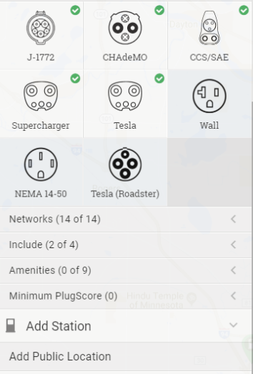
Promote Your Charging Station
Signs help guide users to your station and help to show it off!
Post your charging station on plugshare.com—it’s free
Establish a policy for non-EVs parking in the spot—a small fine or a police warning works well
Notes:
PlugShare is a website people can add charging station locations to. It is very accurate and widely used. It is important for city officials to understand the policy for what happens when a non-EV parks in the spot. Fining people is unnecessary for the most part unless it becomes a prolific targeting issue. Usually, a warning from the police or sheriff is enough to inform people of their mistakes and deter them from doing it again.

Slide 16
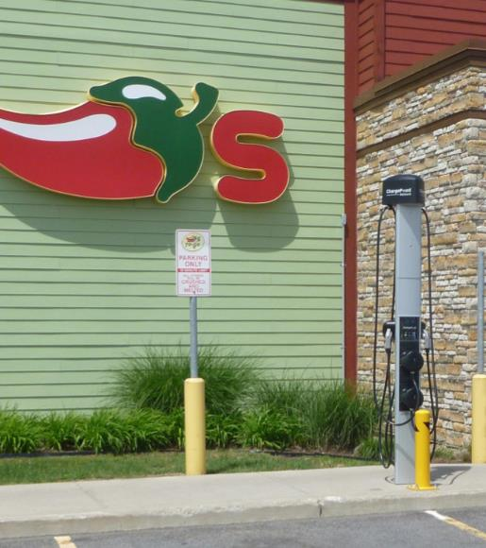
On Site Location Tips
Installing closer to electrical supply equipment reduces costs significantly
Choosing a parking spot in a desirable location indicates you support EV drivers
Well-lit locations help deter vandalism

Slide 17
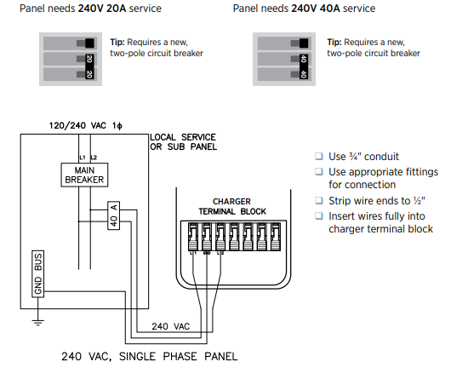
Install Close to Power Supply
Installing near the power supply cuts costs significantly
Refer to the Drive Electric MN installation checklists for more in-depth guidance
From ChargePoint’s guide
Notes:
The cost savings come from the labor and equipment costs to run the lines further and bore further holes.
DEMN Charging Tool: http://www.driveelectricmn.org/charging-guidance/

Slide 18
Future Proofing Your Community
Including conduit and power lines in new development will save you money in the future
Cheaper to lay conduit now than tear up concrete later
Higher kW charging units will prepare you for better battery technology
Notes:
When working on new construction and development, having the electrical equipment ready for EVSE will save you money in the long run. Often times, when installing a new charging station, the biggest costs come from tearing up concrete or drilling holes to install conduit that could have been included with the initial development.

Slide 19
Thank You!
Diana McKeown
MetroCERT Director
dmckeown@gpisd.net
612-278-7158
Kris Acuña
Project Assistant
kacuna@gpisd.net
612-400-6291
Notes:
Instructions: This slide deck is meant to provide you with the necessary resources and talking points you need to educate fleet managers and others about electric vehicles in your community. To use these slides in your own presentation, simply copy and paste the slides you would like to use.
Attribution: This content has been authored and compiled by the Great Plains Institute—credit in any presentation of these slides is not necessary but would be greatly appreciated.

