Slide 2
Adding an EV to Your Fleet

Slide 3
Fleet Studies
Fleet studies track usage, run-time, idling, fuel consumption, and more in vehicles
Companies like FleetCarma install telematic devices to track vehicle data
End data suggests vehicle right-sizes and other improvements that could be made to save money over the life of a vehicle

Slide 4
Fleet Studies in MN
Xcel Energy and Connexus Energy funded fleet studies for cities in their service area
HealthPartners, Bloomington, Coon Rapids, Faribault, Fridley, Hastings, Inver Grove Heights, St. Louis Park, White Bear Lake, Winona, and Woodbury have done studies
Notes:
Fleet studies are proving to be a very valuable source of data.

Slide 5
FleetCarma’s Process

Slide 6
Faribault Fleet Study
Replacing Faribault’s 2017 Ford Explorer with a Mitsubishi Outlander PHEV would save the city $9,061.59
Of the 20 vehicles tested in Faribault, FleetCarma recommended that 6 of them should be replaced with BEV or PHEVs for significant savings
Funded by Xcel Energy
Notes:
Contact Dave Wanberg (dwanberg@ci.faribault.mn.us) for more information on the fleet study

Slide 7
Faribault Fleet Study
FleetCarma calculates which vehicles are a best fit for replacement based on driving patterns and data
Notes:
Contact Dave Wanberg (dwanberg@ci.faribault.mn.us) for more information on the fleet study

Slide 8
Partners in Energy
Willing to work with your community to accomplish your goals (including EV ones!)
Direct assistance
www.xcelenergy.com/FleetElectrificationForm
E-mail: ElectricVehicles@xcelenergy.com
Notes:
Applicable for cities within Xcel Energy’s service area. For more information on Partners in Energy: https://www.xcelenergy.com/working_with_us/municipalities/partners_in_energy

Slide 9
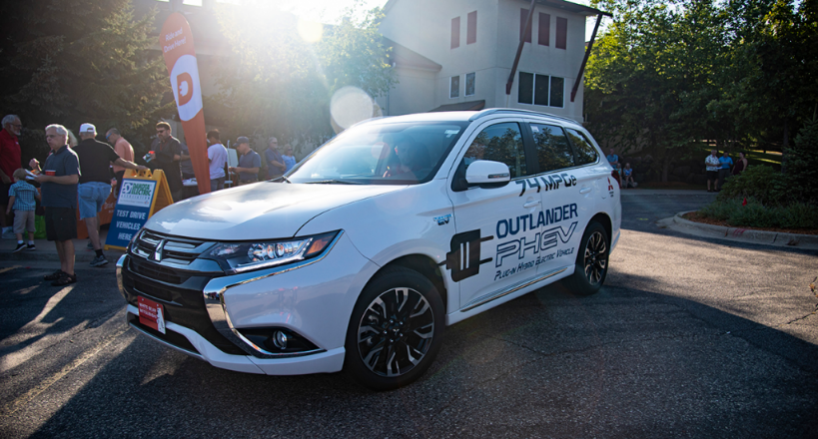
Connexus
Connexus Energy funded Coon Rapids’ fleet study
Connexus Energy offers a $500 dollar rebate for level 2 charging stations

Slide 10
Local governments can lease/purchase vehicles from the state contract
State contract provides discounts on select vehicles, including EVs
Can get a Chevy Volt for $32,679 compared to the $33,220 sticker price

Slide 11
Cooperative purchasing venture
Can buy charging equipment as well as vehicles
Can purchase a $37,495 Chevy Bolt for $32,702 via Sourcewell
Notes:
https://www.sourcewell-mn.gov/

Slide 12
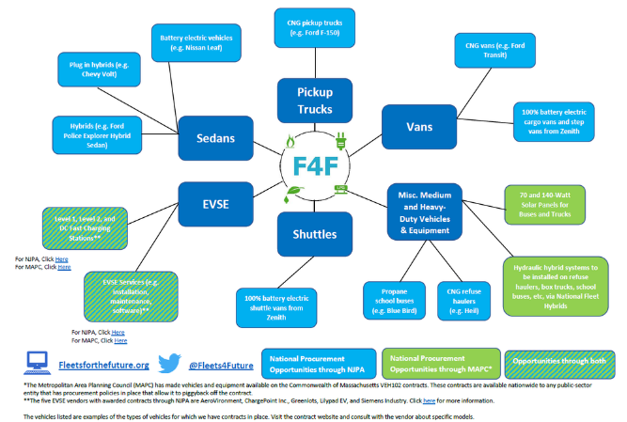
National partnership working to coordinate procurement initiatives designed to consolidate bulk orders of alternative fuel vehicles and infrastructure
Regional and national initiatives
Notes:
Fleets for the Future (F4F) is a national partnership of regional councils, Clean Cities coalitions, and industry experts tasked with coordinating five regional and one national procurement initiative designed to consolidate bulk orders of alternative fuel vehicles and infrastructure.

Slide 13
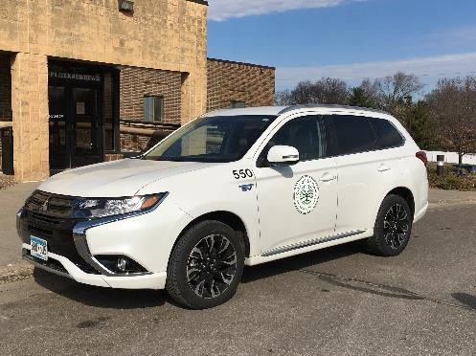
Eagan purchased a new Mitsubishi Outlander and used a creative solution to take advantage of the federal tax credit
By leasing through Ally Bank, the tax credit still applied, and Ally Bank offered the city a $4,800 rebate
They bought out the lease almost immediately, but still got it at a lower price than the state contract!
Photo from City of Eagan

Slide 14
2020 Police Interceptor
Coming in 2020, Ford will offer a hybrid Interceptor
The EV market is expanding
Vehicles that idle frequently are perfect to be replaced with EVs
Star Tribune article highly praises these vehicles
Notes:
It’s unclear at this time whether the 2020 Ford hybrid Interceptor will be plug-in or not. Find out more at https://www.ford.com/police-vehicles/hybrid-utility/
Star Tribune article: http://www.startribune.com/police-vehicle-is-not-your-typical-hybrid/510560282/?refresh=true

Slide 15
Thank You!
Diana McKeown
MetroCERT Director
dmckeown@gpisd.net
612-278-7158
Kris Acuña
Project Assistant
kacuna@gpisd.net
612-400-6291
Notes:
Instructions: This slide deck is meant to provide you with the necessary resources and talking points you need to educate fleet managers and others about electric vehicles in your community. To use these slides in your own presentation, simply copy and paste the slides you would like to use.
Attribution: This content has been authored and compiled by the Great Plains Institute—credit in any presentation of these slides is not necessary but would be greatly appreciated.

