Slide 1
Fleet Best Practices

Slide 2
Use Your New EV
Assign your fleet EVs where they will get used
Every mile driven in an EV is more benefit to your city
Encourage use whenever possible for maximum cost/environmental savings

Slide 3
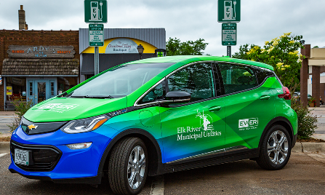
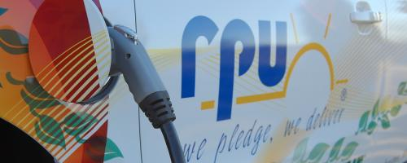
Fleet Vehicle Branding
“Electric vehicles (EVs) are a great fit for ERMU because they give us the opportunity to provide educational information and demonstrations on an electric product that is environmentally friendly and financially responsible for our customers.”
– Tom Sagstetter,
Conservation and Key Accounts Manager
Elk River’s Chevy Bolt is brightly colored and highly visible!
Rochester Public Utility has it painted right on the vehicle

Slide 4
Train City Employees
Host a training for city employees to educate them on the new EV
Employees become more comfortable driving the vehicle and save the city money
City employees can help educate and answer questions about the EV from the community

Slide 5
Plug the Vehicle in Overnight!
Make sure city employees know to plug the vehicle in overnight
Helpful to have maintenance staff monitor this
If it does not get plugged in, it may not have the necessary range for the next day

Slide 6
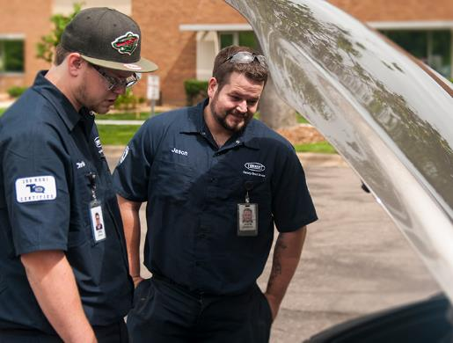
Host a City Employee Ride and Drive
A ride and drive lets city employees test out an EV for themselves
EV owners in your community love sharing about their EV
Ride and drives are the best way to show employees the benefits of EVs
Notes:
Drive Electric MN has a free comprehensive ride and drive toolkit, also will help if your organization needs more hands on assistance planning an event. Find it here: https://www.driveelectricmn.org/electric-vehicles/ride-and-drive/

Slide 7
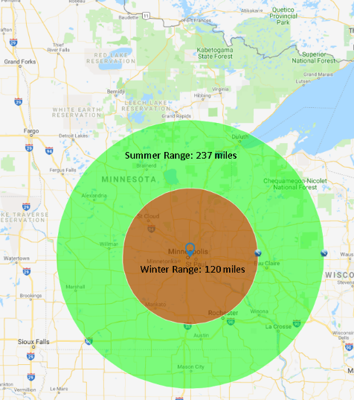
Keep Resources in the Glove Box
Include resources for city employees in the glove box
A range map
Elevator pitch to give to curious community members
User guide for the EV
Instructions about how to charge the EV
Image courtesy University of Minnesota
Notes:
A range map shows how far the EV can go in one charge. Target these resources to make sure that any city employee that uses the EV can find what they need to answer questions about using the EV for work!

Slide 8
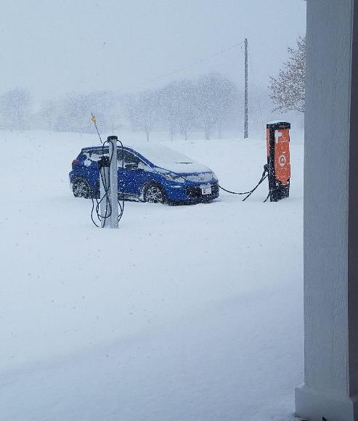
“EVs do not have enough traction for winter”
More all-wheel drive EVs are coming to market each year
Consumer Reports claims that using snow tires matters significantly more than 2WD vs. 4WD in breaking, turning, and accelerating in snow
Notes:
Source for tire testing: https://www.consumerreports.org/cro/magazine/2015/09/do-you-really-need-awd-in-the-snow/index.htm

Slide 9
Thank You!
Diana McKeown
MetroCERT Director
dmckeown@gpisd.net
612-278-7158
Kris Acuña
Project Assistant
kacuna@gpisd.net
612-400-6291
Notes:
Instructions: This slide deck is meant to provide you with the necessary resources and talking points you need to educate fleet managers and others about electric vehicles in your community. To use these slides in your own presentation, simply copy and paste the slides you would like to use.
Attribution: This content has been authored and compiled by the Great Plains Institute—credit in any presentation of these slides is not necessary but would be greatly appreciated.

